Slide 1
Assignment 1

Slide 2
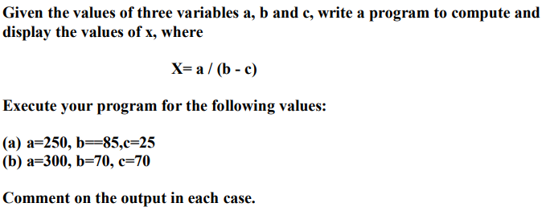

1
2

Slide 3



3
4

Slide 4


5
6

Slide 5
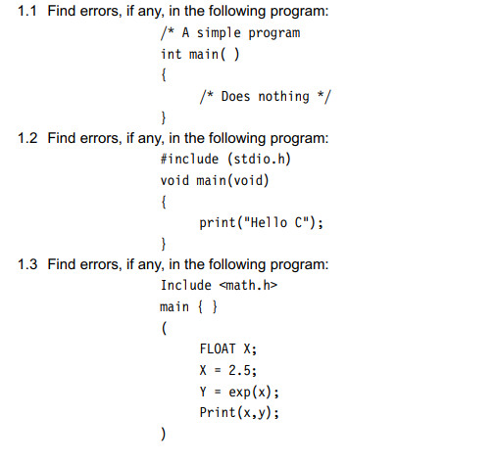
Debug

Slide 6
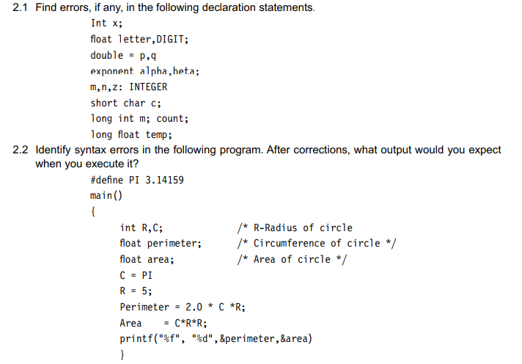
Debug

Slide 7
Thank You

